Slide 1
The Heroes of Our Class
Class 1 A I.C. Sciascia-Caruano
Plesso “A.Campanella”
eTwinning Project

Slide 2
In this activity, students created drawings of their personal heroes.
Heroes can be family members, superheroes, or people who help others.
Through art and creativity, students shared what being a hero means to them.

Slide 3
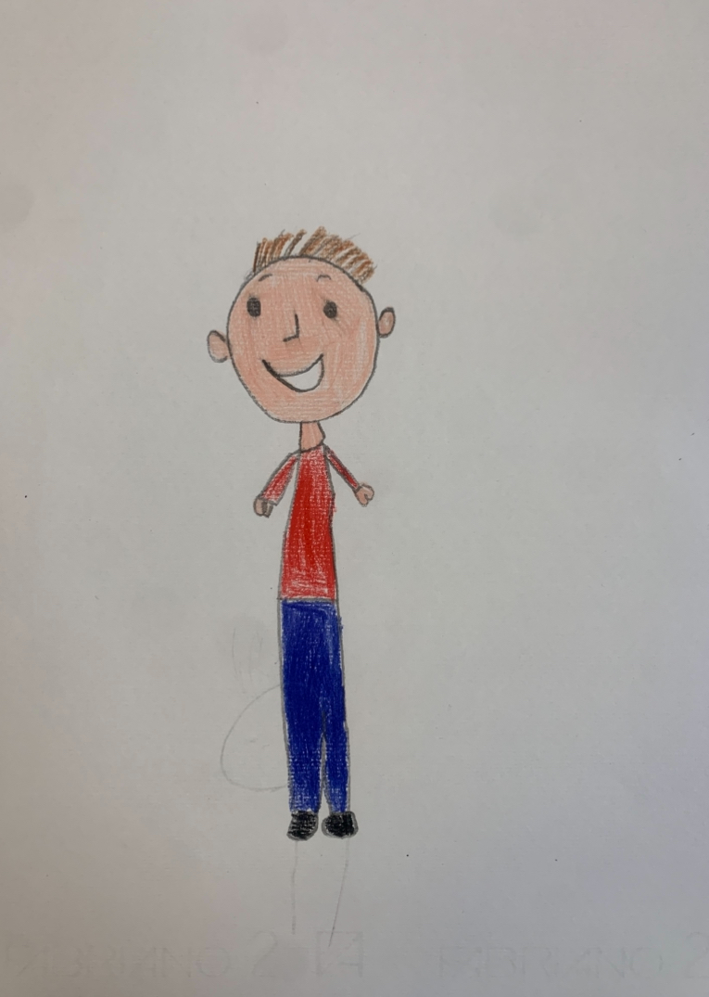
My dad is my hero

Slide 4
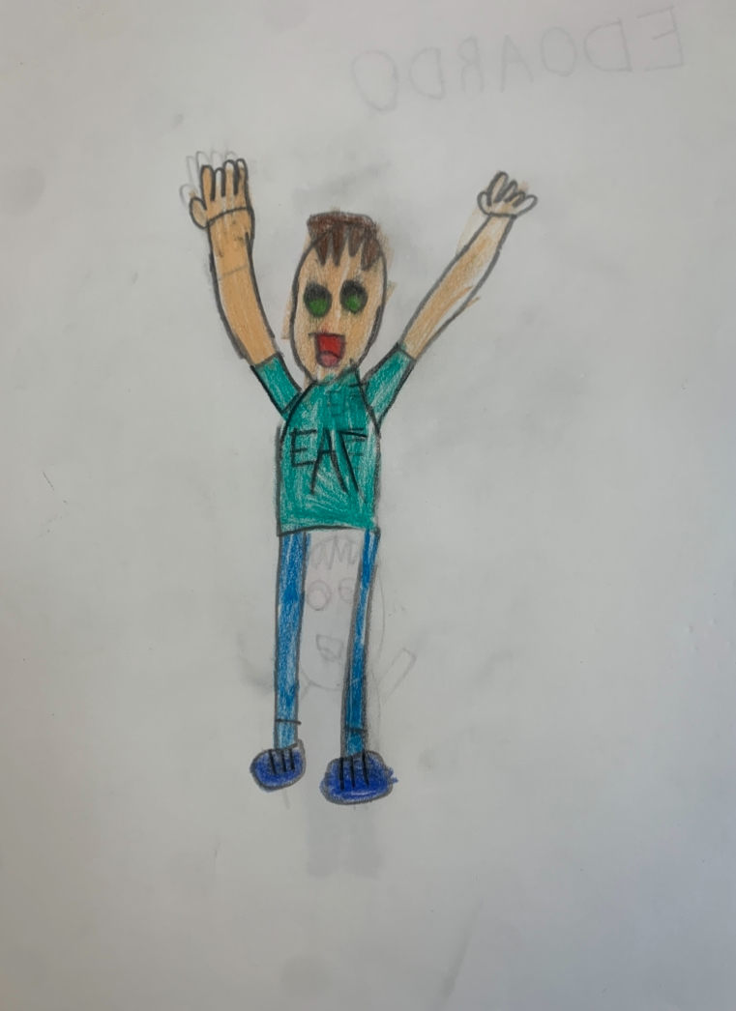
My dad protects me

Slide 5
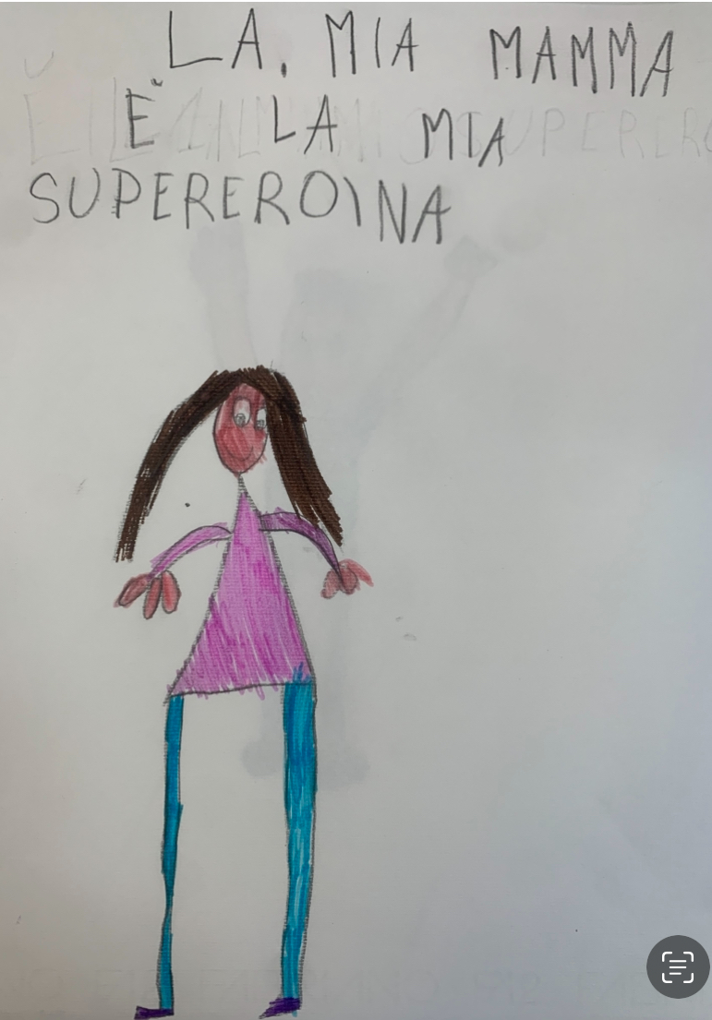
My mum, my superhero

Slide 6
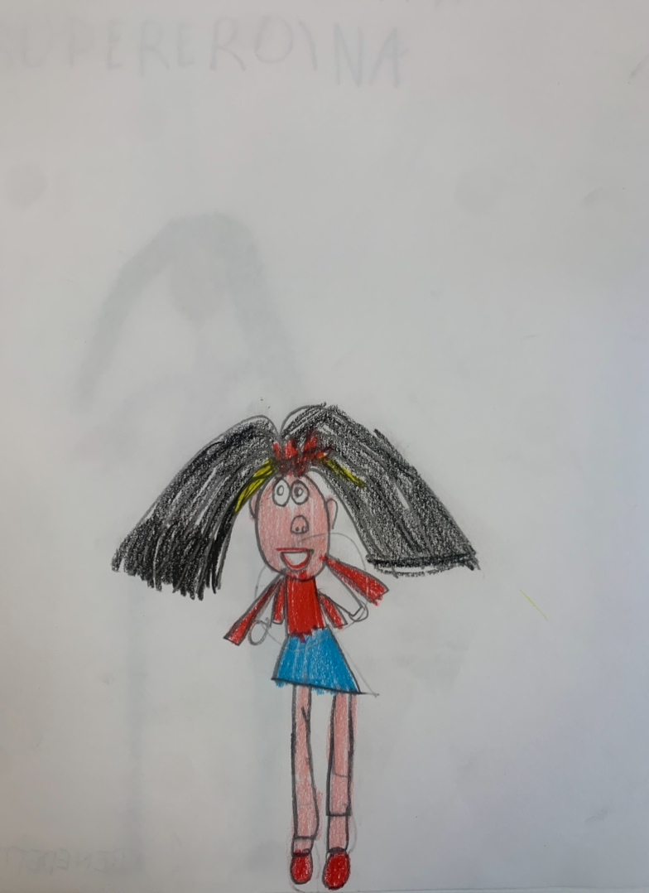
A strong and funny hero

Slide 7
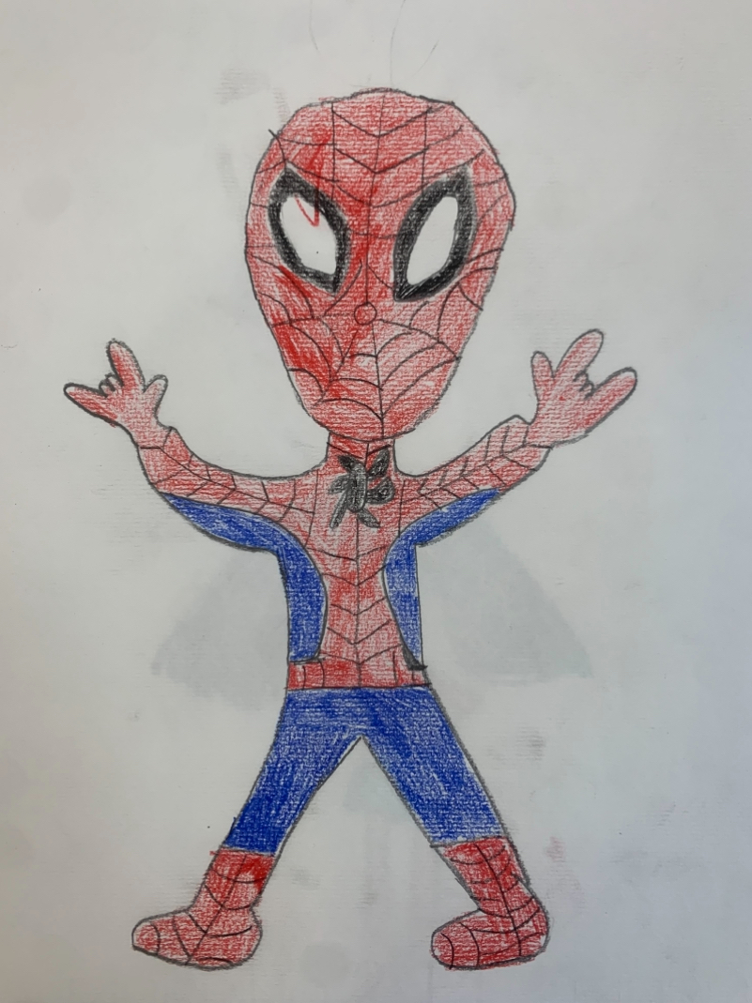
A colorful and positive hero

Slide 8
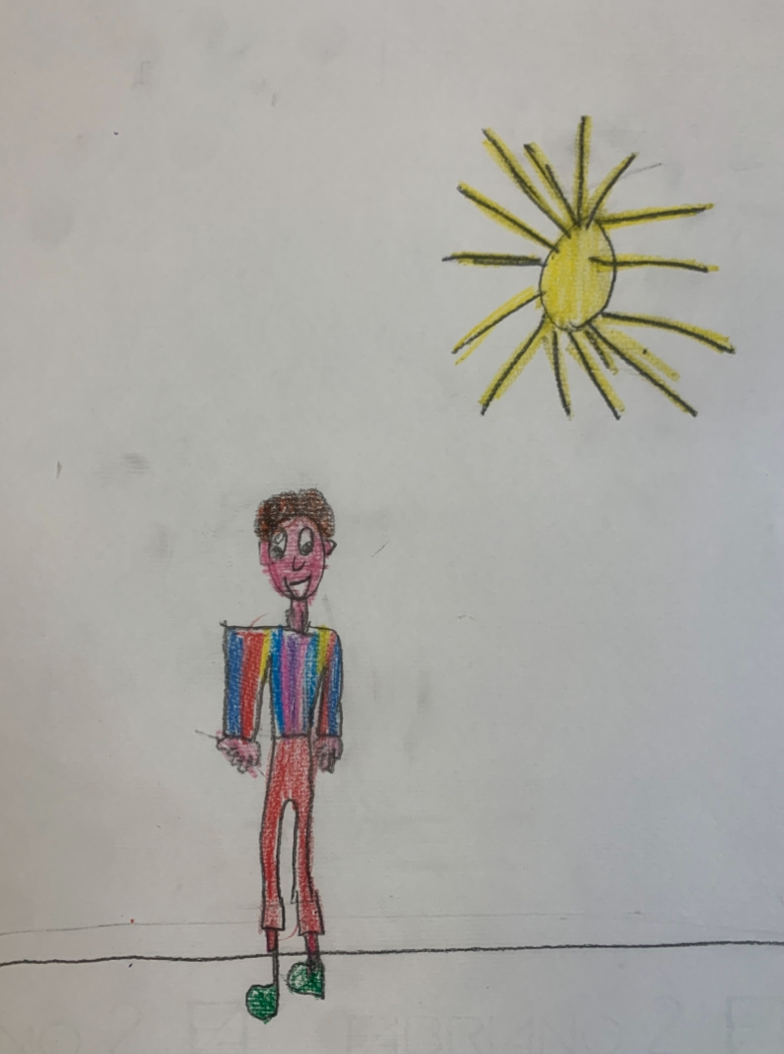
My dad is my superhero

Slide 9
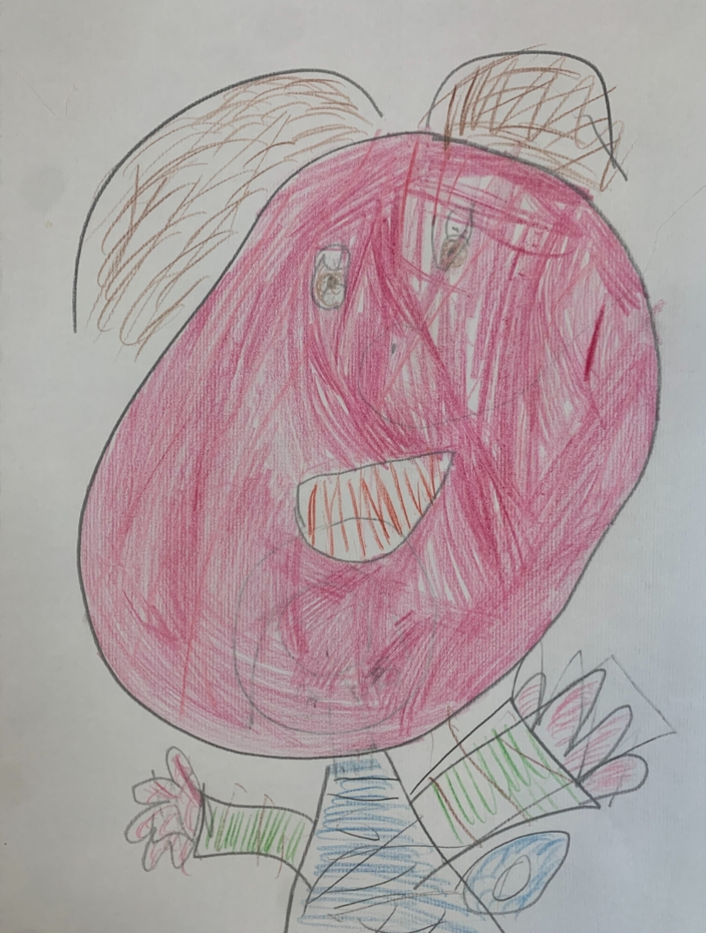
My mum is strong and kind

Slide 10
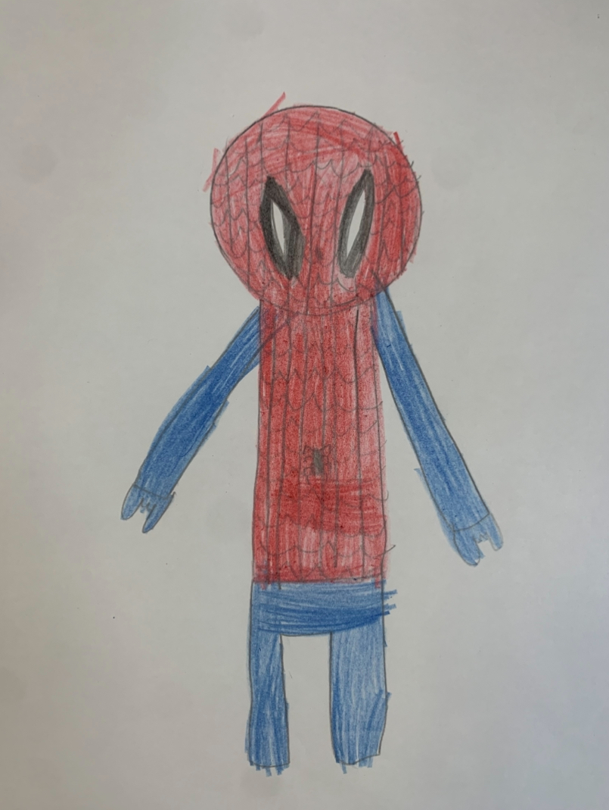
A brave hero

Slide 11
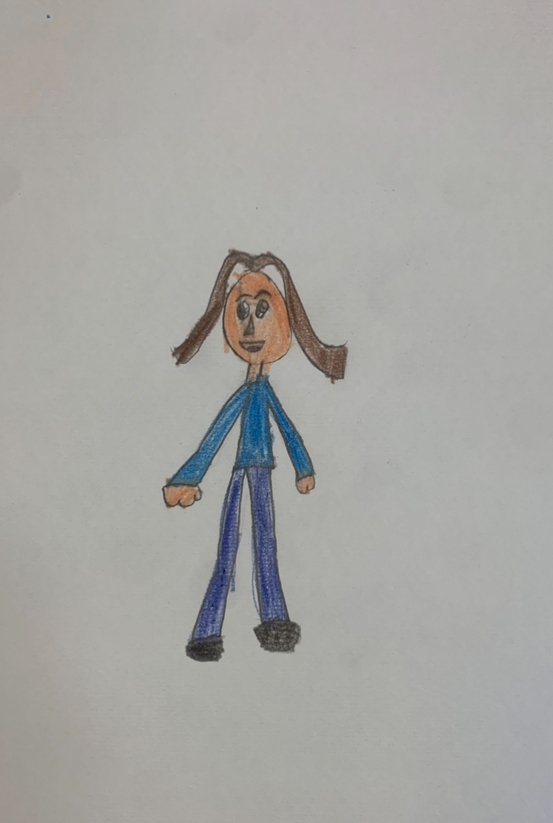
A special hero: my MUM!

Slide 12
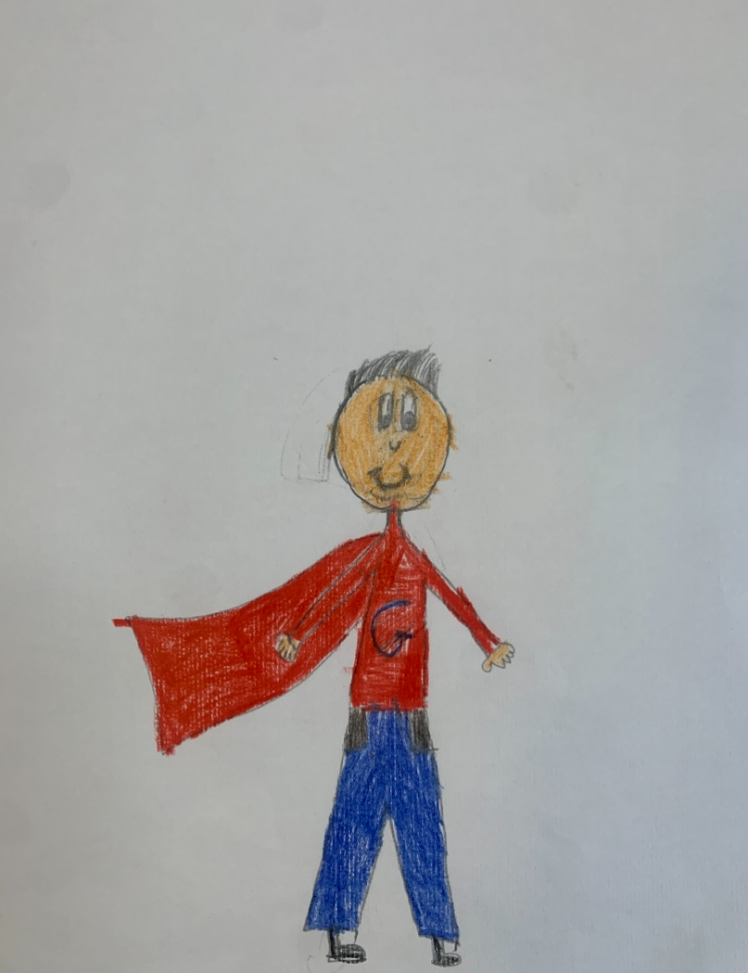
A flying hero: my DAD!

Slide 13
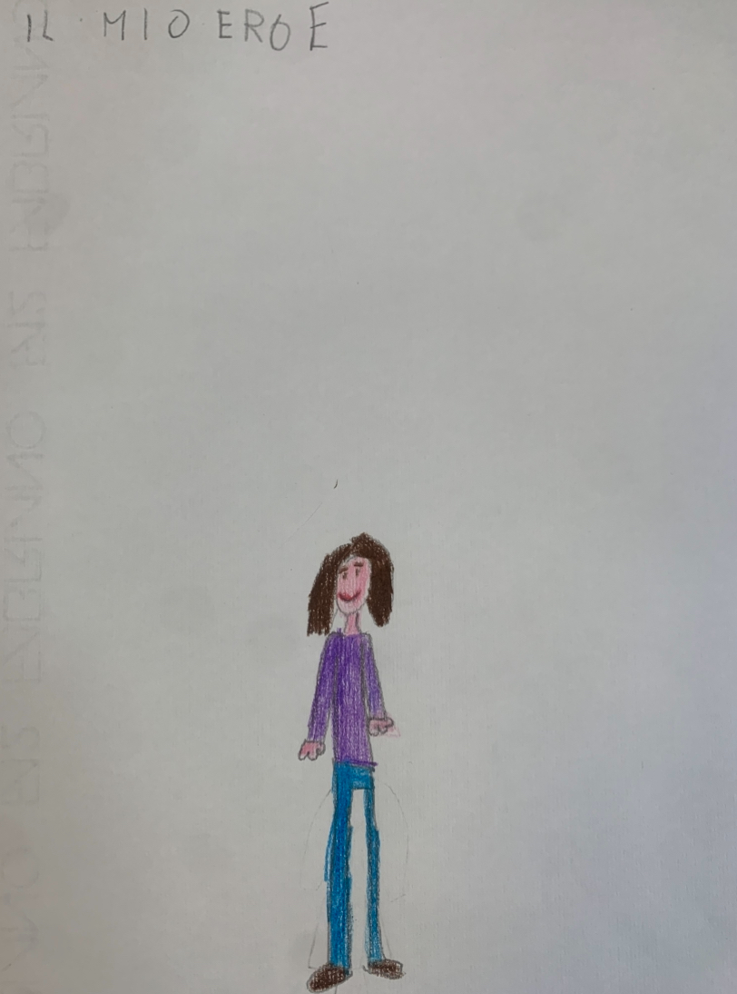
My mum helps me every day

Slide 14
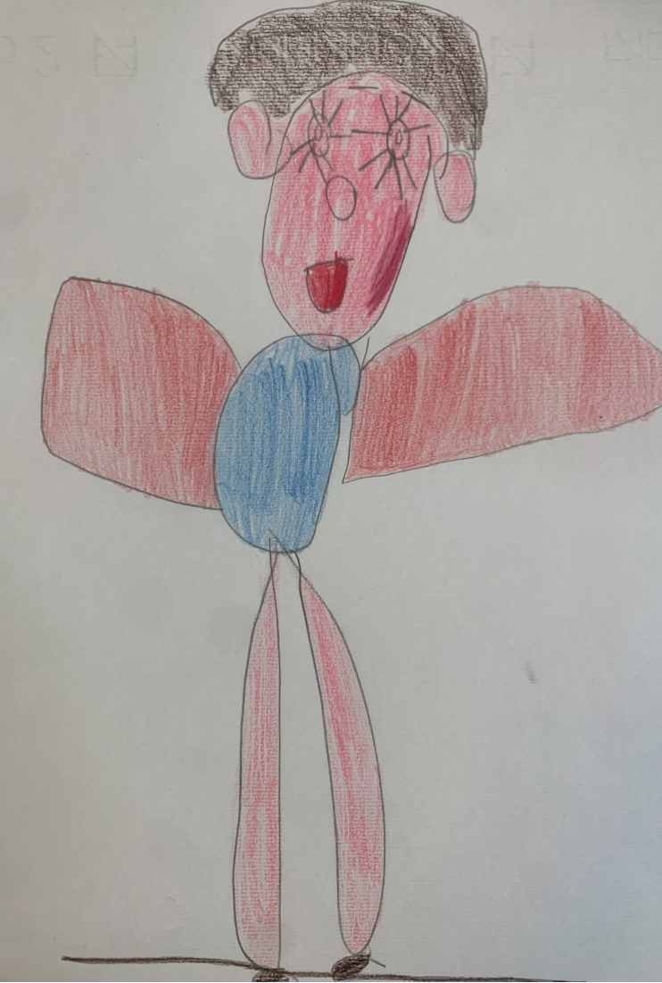
My superhero: my MUM!

Slide 15
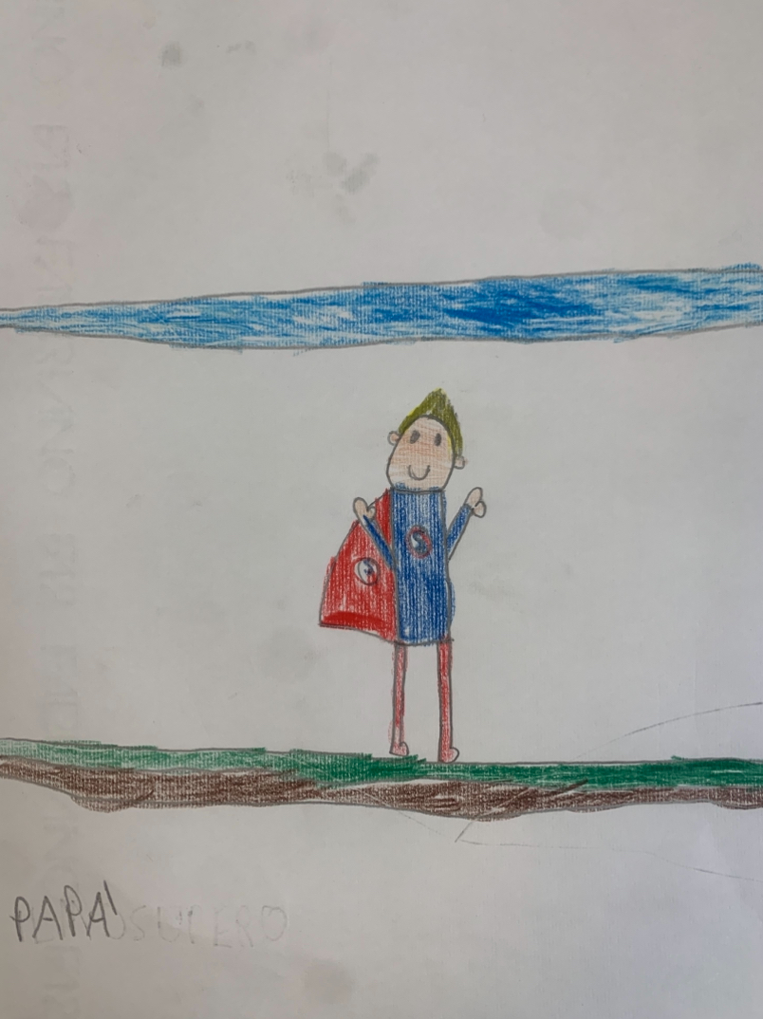
A friendly hero

Slide 16
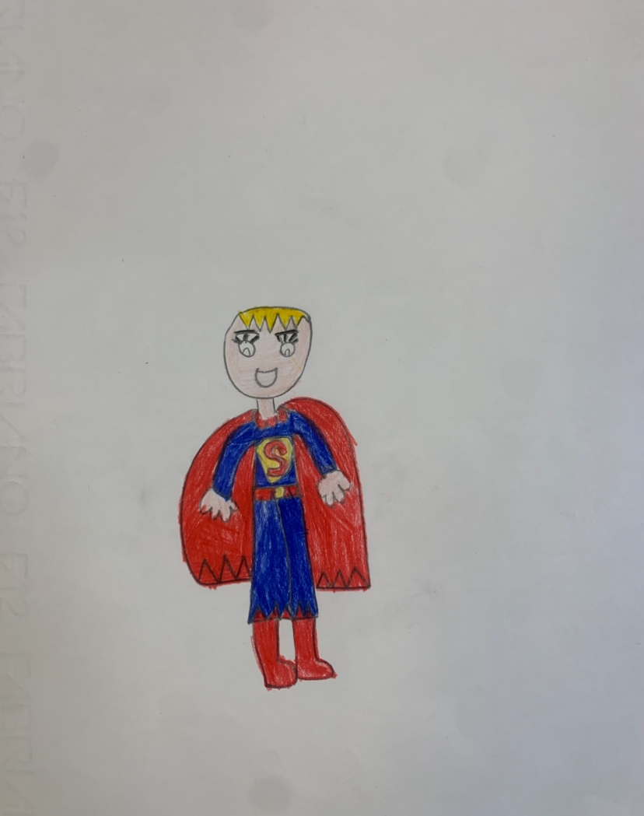
A young hero with courage

Slide 17
Thank you for watching our heroes!

